Slide 1
Chinook Sales Analysis

Slide 2
Problem statement
You are hired as a data analyst at Chinook, and your objective is to analyze music record sales data to gain insights and make recommendations for the company's strategy in the physical music market.

Slide 3
Data description
customer:
customer_id: Unique identifier assigned to each customer.
first_name: The given name or first name of a customer.
last_name: The surname or family name of a customer.
company: The name of the company associated with a customer.
address: The street address of a customer's location.
city: The city where a customer is located.
state: The state or province where a customer is located.
country: The country where a customer is located.
postal_code: The postal or zip code of a customer's address.
phone: The phone number of a customer.
fax: The fax number associated with a customer.
email: The email address of a customer.
support_rep_id: The employee ID of the support representative assigned to a customer.
invoice:
invoice_id: Unique identifier assigned to each invoice.
customer_id: The customer ID associated with the invoice.
invoice_date: The date when the invoice was generated or issued.
billing_address: The street address used for billing purposes.
billing_city: The city used for billing purposes.
billing_state: The state or province used for billing purposes.
billing_country: The country used for billing purposes.
billing_postal_code: The postal or zip code used for billing purposes.
total: The total amount due on the invoice.

Slide 4
Data description
invoice:
invoice_id: Unique identifier assigned to each invoice.
customer_id: The customer ID associated with the invoice.
invoice_date: The date when the invoice was generated or issued.
billing_address: The street address used for billing purposes.
billing_city: The city used for billing purposes.
billing_state: The state or province used for billing purposes.
billing_country: The country used for billing purposes.
billing_postal_code: The postal or zip code used for billing purposes.
total: The total amount due on the invoice.
invoice_line:
invoice_line_id: Unique identifier assigned to each line item on an invoice.
invoice_id: The invoice ID to which the line item belongs.
track_id: The ID of the track or product included in the line item.
unit_price: The price per unit for the line item.
quantity: The quantity of units for the line item.
playlist:
playlist_id: Unique identifier assigned to each playlist.
name: The name or title of the playlist.
playlist_track:
playlist_id: The ID of the playlist to which the track belongs.
track_id: The ID of the track included in the playlist.
track:
track_id: Unique identifier assigned to each track or song.
name: The title or name of the track.
album_id: The ID of the album to which the track belongs.
media_type_id: The ID of the media type associated with the track.
genre_id: The ID of the genre associated with the track.
composer: The name of the composer or artist who composed the track.
milliseconds: The duration of the track in milliseconds.
bytes: The file size of the track in bytes.
unit_price: The price per unit for the track.

Slide 5
Data description
album:
album_id: Unique identifier assigned to each album.
title: The title or name of the album.
artist_id: The ID of the artist associated with the album.
artist:
artist_id: Unique identifier assigned to each artist.
name: The name of the artist.
media_type:
media_type_id: Unique identifier assigned to each media type.
name: The name or description of the media type (e.g., MPEG audio file, AAC audio file).
genre:
genre_id: Unique identifier assigned to each genre.
name: The name or description of the genre (e.g., rock, pop, classical).

Slide 6
Methodology
1. Data Preprocessing :-
Removing columns like Address, postal code, phone number and other unwanted columns which have no part in analysis.
This is done using duplicating the original table and taking only the required columns in the copied table
2. Data Cleaning
Removing columns like state from customers and employee table as there are null values and keeping City and Country columns are enough for analysis.
There were some data inconsistencies in playlist_track table in playlist_id column where ids like 8 and 10 have same values as 1 and 3 ids repectively. They were causing data mapping problems with track table.
There were no duplicate rows in almost all tables.
3. Data Analysis
Calculated various KPIs (Key Performance Indicators) like Total revenue, Churn Rate, Total Customers.
Done analysis on Top Artists, Top Genres, Top Albums, Customer Purchasing Behaviour, Product Affinity, Regional Market, Customer Risk Profiling, Customer Lifetime Value Modelling

Slide 7
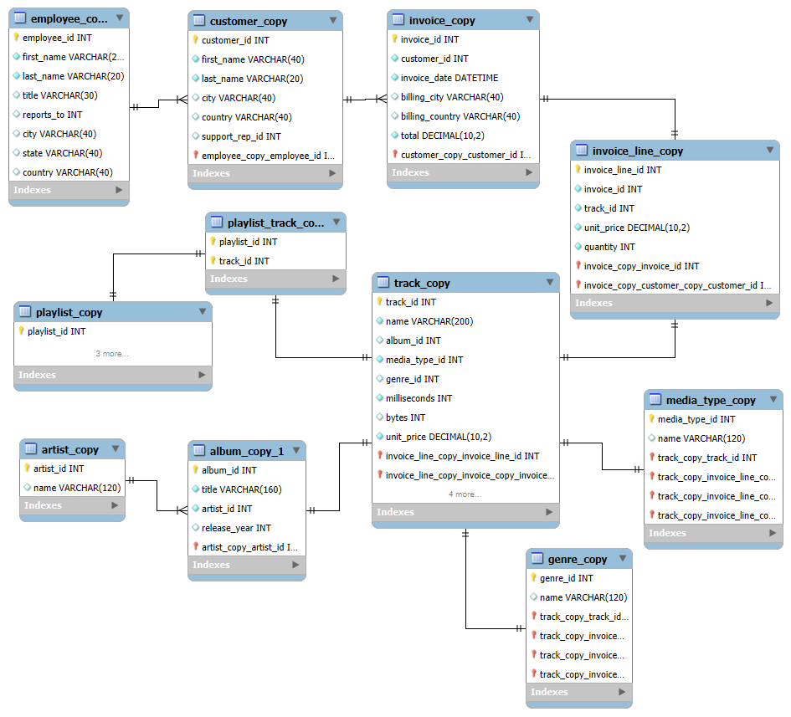
Database Schema

Slide 8


Key Performance Indicators
Total Customers
Total Revenue

Slide 9
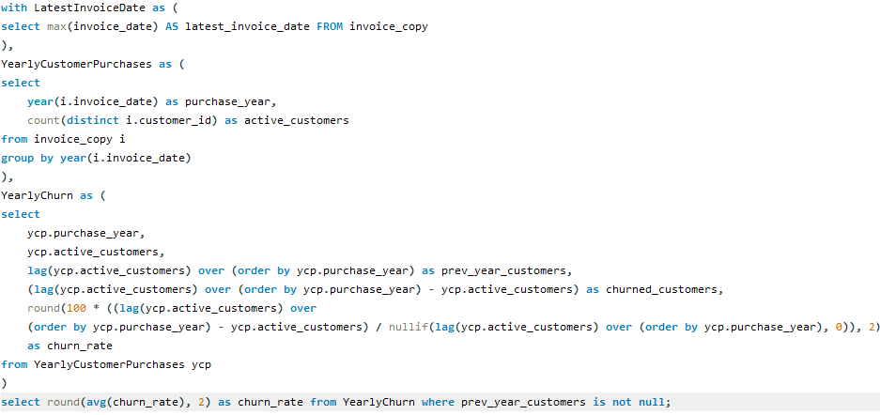

Key Performance Indicators
Churn Rate

Slide 10
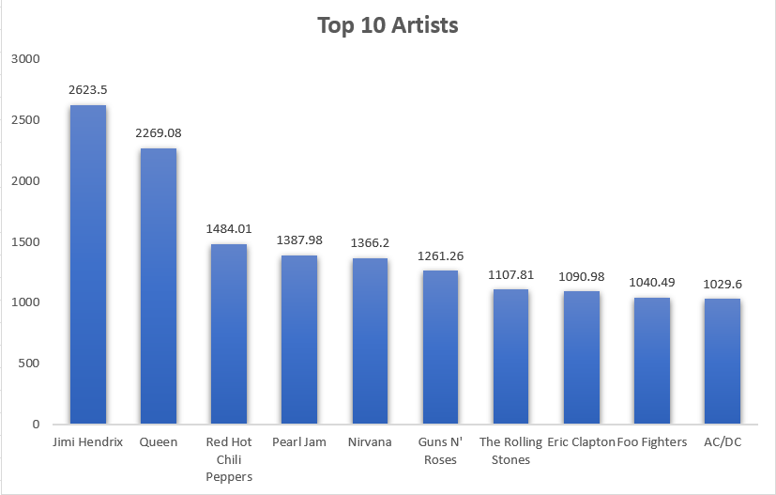
Top 10 Artists

Slide 11
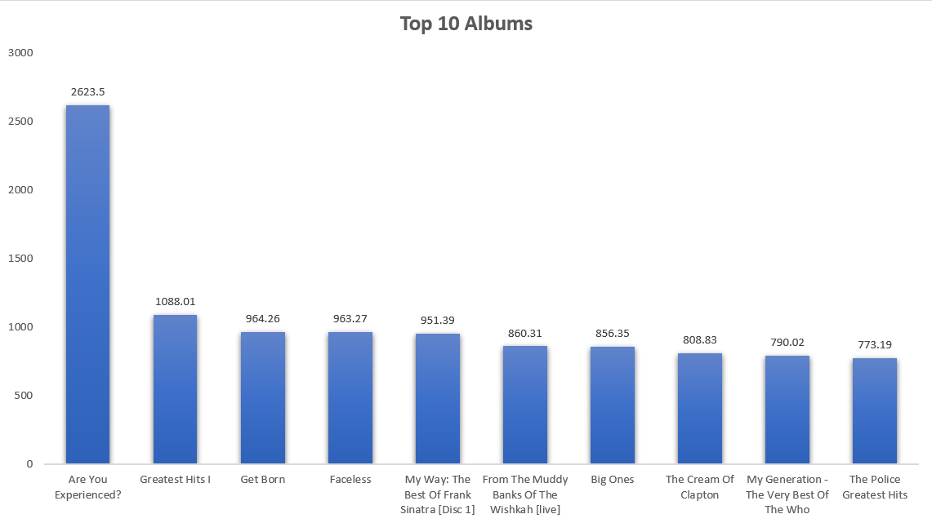
Top 10 Albums

Slide 12
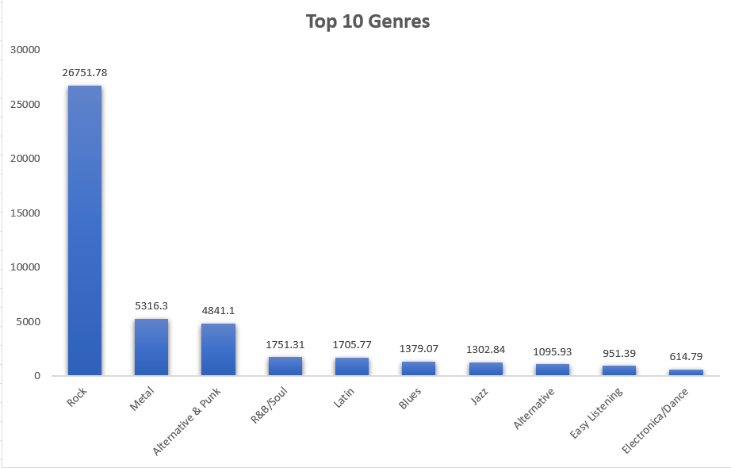
Top 10 Genres

Slide 13
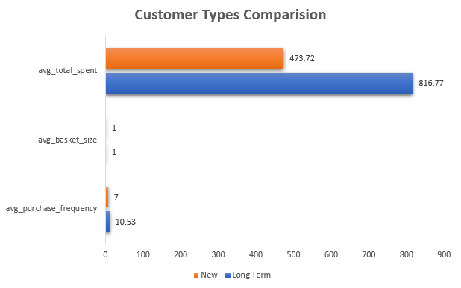
Customer Purchasing Behaviour
Here I have considered Customers as long term customers, who are purchasing since last 3 years of their last purchases.
Analysis Points :-
Customers are not buying in bulk whether they are new or long term
Long term customers have higher average total spent and average purchase frequency showing the trust in the company.

Slide 14
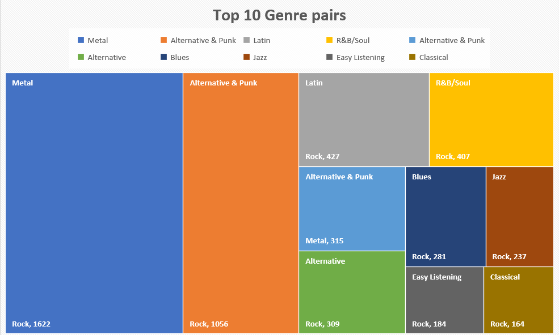
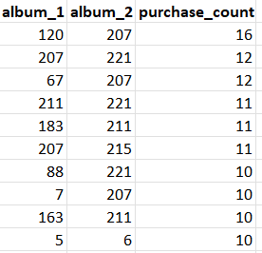
Product Affinity
In this we analyse that what type of Genre pairs and album pairs people like most or purchased most.
This will help company to decide on what genres, artists, albums etc. they have to put discounts and promote more these kinds of products.

Slide 15
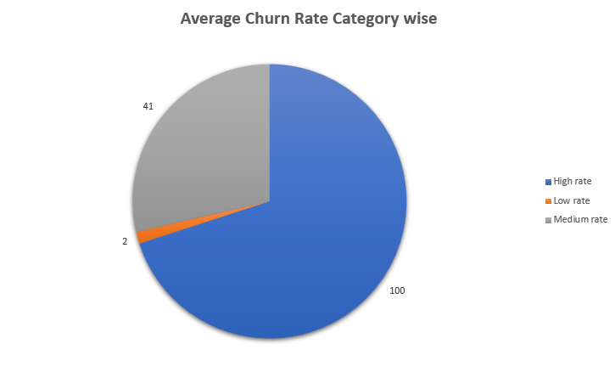
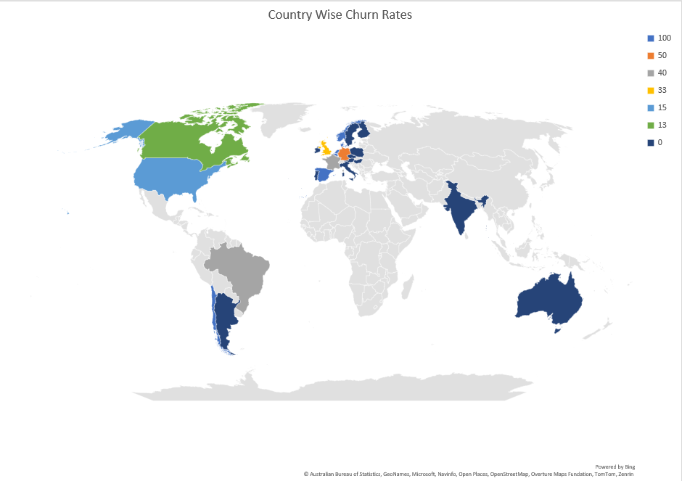
Regional Market
In this we analyse that how company is performing in different countries, cities all over the world. For this we used Country wise churn rate analysis with Categorising customers with High, Medium and Low Rate.
Churn rate here is calculated in period of 6 months.
Countries having low churn rates, there company is performing well and countries having high churn rates, it is better to look to other countries which have more love to music and specially for physical music media.

Slide 16
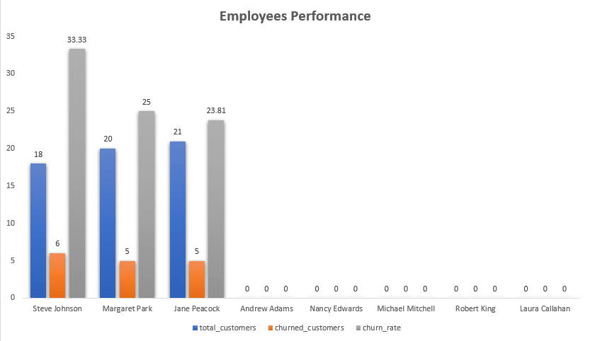
Customer Risk Profiling
In this we analyse that which customer category is most likely to churn or pose higher risk of reduced spending.
This can be analysed using Employees performance who are resolving customer issues.
From the chart given we can see that only 3 employees are handling all the customers leading to high risk of churn rates.

Slide 17
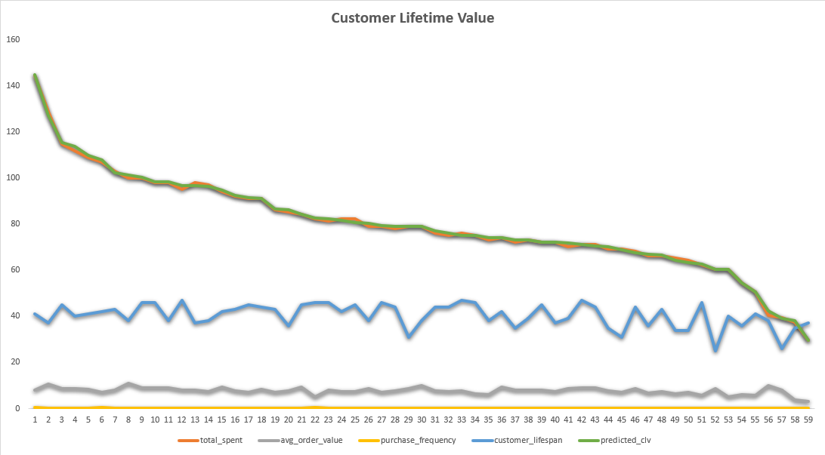
Customer Lifetime Value Modelling
In this we analyse total net profit a company can generate from a customer over their entire relationship with the business. This is CLV by definition and it is predicted using a formula :-CLV = Average Order Value × Purchase Frequency × Customer Lifespan
A higher CLV indicates that a customer is generating more revenue for the business over time, which is generally viewed as more desirable.
From the line graph, predicted value is almost same as Total spent.
We need to focus on initial customers who have higher CLV for targeted marketing and loyalty program strategies

Slide 18
Recommendation
It is better time to create a online selling and subscription based Music Platform as nowadays physical media purchasing is declining.
Company need to create strategies like some Loyalty programs for their long term and High CLV Customers to retain their interest and believe in the company.
For acquiring new customers, company need to set up events and more importantly tie up with Music directors, Musicians to promote and sell their brands all over the world.
Company need to focus primarily on those countries where physical media is still popular and secondly on countries where Music Industry is large and huge amount of Music is generated every year like USA, India etc.
Company also need to focus on services they are providing as it directly impacts churn rate. For that they need to divide work among employees and create trainings for them on how to resolve and talk to customers regarding their problems and issues

Slide 19
Conclusion
As Physical Media sales still on decline, it is better for companies to move on online mode. But Chinook has almost 0 churn rate which shows that there are people who loves to listen songs using CDs, Cassettes and other physical music media and Company has done great to hold on these Customers. Promoting their best sellers, organising events and teeing up with Popular Artists will help the company in increasing their revenue.

Slide 20


